Slide 1

Skip The Line
cc: CucombreLibre - https://www.flickr.com/photos/33200530@N04

Slide 2

Who am I
cc: Alex Iby - https://unsplash.com/@ibydesigns?utm_source=haikudeck&utm_medium=referral&utm_campaign=api-credit
Notes:
test

Slide 3

Outline
Theme Park Tech
WebSockets
Observables
React.js Client
cc: KJGarbutt - https://www.flickr.com/photos/25187937@N05

Slide 4

Let's talk about themeparks
cc: Jason Chen - https://unsplash.com/@ja5on?utm_source=haikudeck&utm_medium=referral&utm_campaign=api-credit
Notes:
What is the worst part about going to a theme park?

Slide 5

Imagine a park where you accessed rides via a virtual line
cc: Leonrw - https://www.flickr.com/photos/28435348@N04

Slide 6
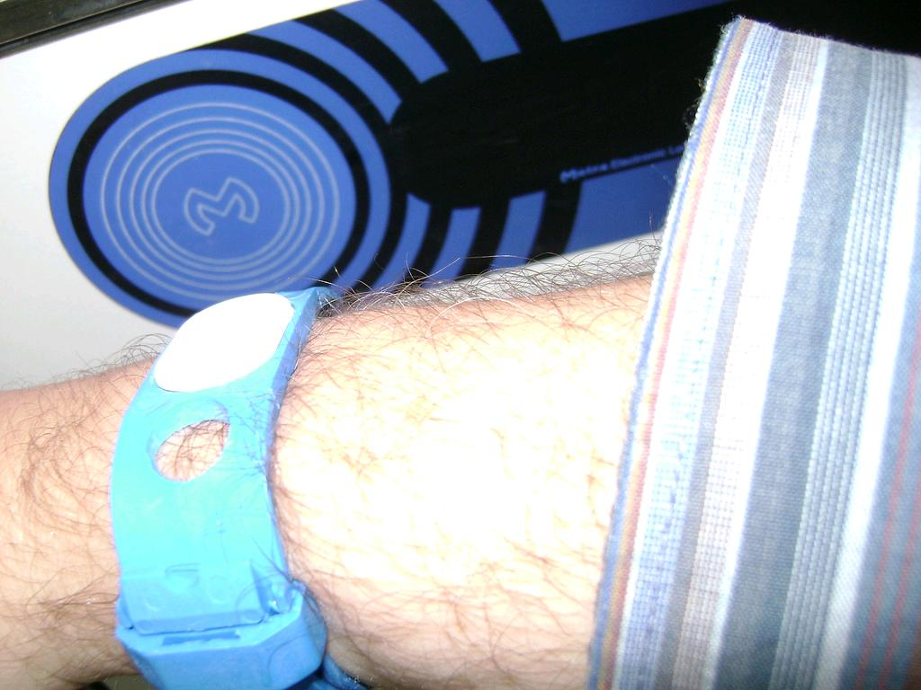
You touch a wearable device to a sensor and then go one your way
cc: Luc Van Braekel - https://www.flickr.com/photos/47211037@N00

Slide 7

Radio Frequency ID
Specs: ISO/IEC 15693, ISO/IEC 14443
Non-standardized: MiFare, Felica others
Notes:
Uses electromagnetic fields to active tag and share the data stored on the device

Slide 8
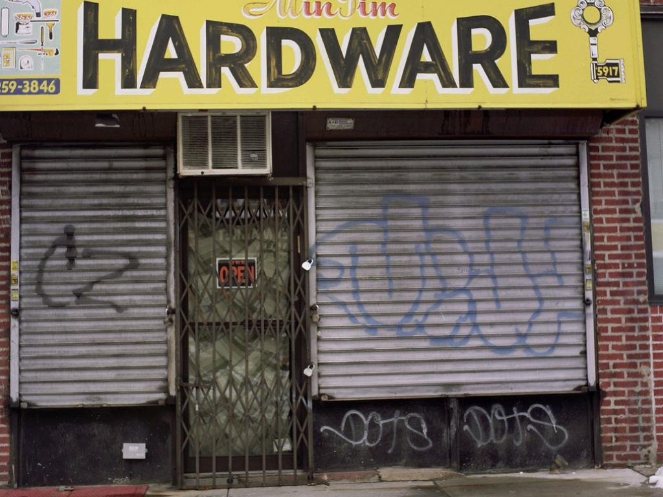
RFID IS COOL AND CHEAP!!
cc: 12th St David - https://www.flickr.com/photos/59816658@N00
Notes:
We’ll be using a device that shows up as an HID device (ie. Keyboard)

Slide 9
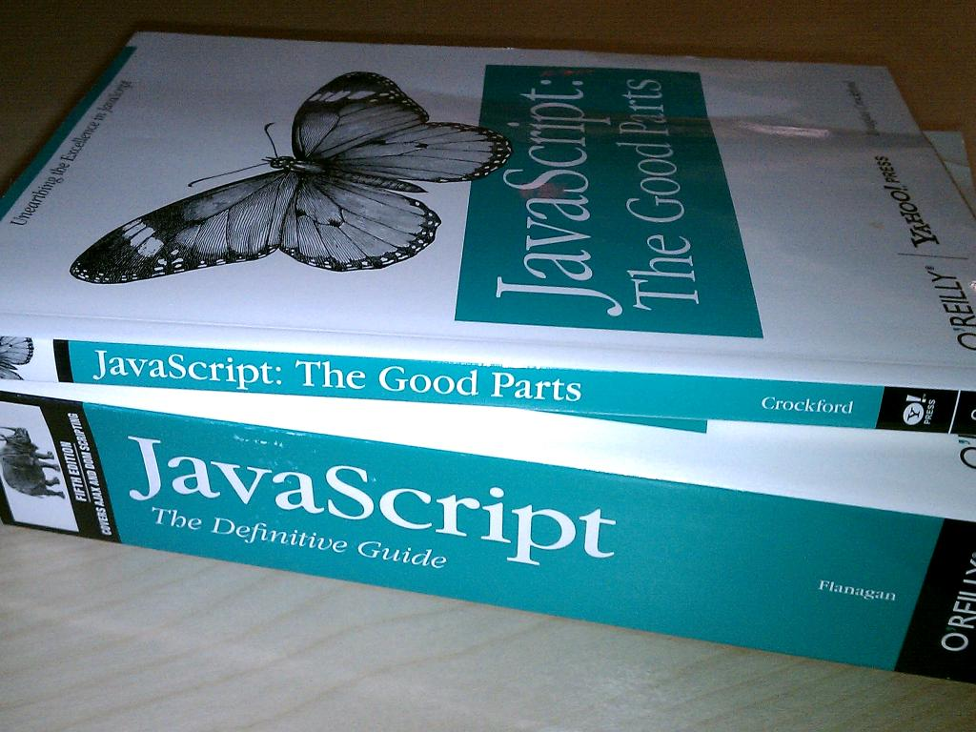
Time to build
cc: OÐ»ÑÐ³Ð° + HaÑaÐ½ - https://www.flickr.com/photos/42182644@N00
Notes:
Javascript WTF, big javascript node shop. Wanted web based as well.

Slide 10

How to notify our front-end when someone touches their wearable?
cc: Marcus Q - https://www.flickr.com/photos/41896843@N00

Slide 11

Lets Use WebSockets
cc: Carbon Arc - https://www.flickr.com/photos/41002268@N03

Slide 12
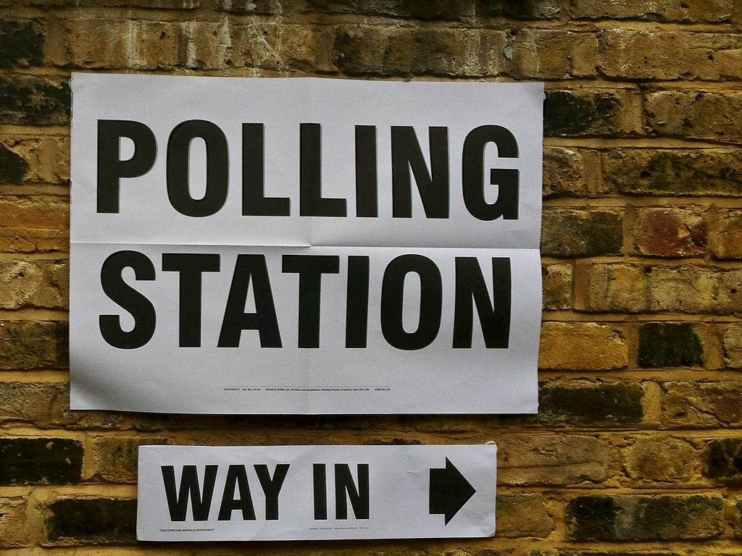
But Why?
cc: secretlondon123 - https://www.flickr.com/photos/25834786@N03

Slide 13
WebSockets
Bi-directional Stream
Socket.io, SignalR
All major browsers
Specs: RFC 6455

Slide 14
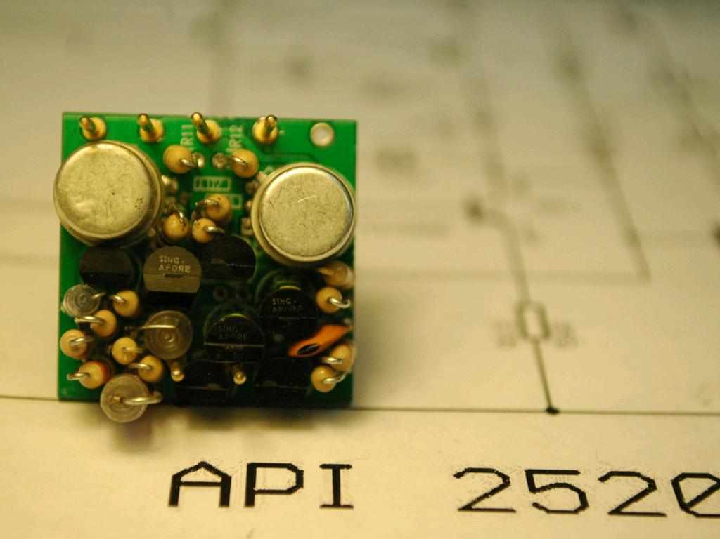
How will this work?
cc: 6SN7 - https://www.flickr.com/photos/47800690@N03

Slide 15
Design!
RFID
RFID
Reader
Notes:
User touches RFID media to RFID Reader

Slide 16
Design!
RFID
RFID
Reader
Node
Server
Notes:
RFID Reader sends that data to our server side application, this application will also serve up our simple website and our

Slide 17
Design!
RFID
RFID
Reader
Node
Server
Client-Side
JavaScript
Notes:
WebSocket connection sends a message to Javascript on the front-end that will show the data to the user of the application

Slide 18

Ok, let’s code it up
cc: Lord James [Web Developer] - https://www.flickr.com/photos/51098911@N07

Slide 19
Yarn
➜ rvajsconf2017-talk yarn add express
➜ rvajsconf2017-talk yarn add socket.io

Slide 20
Dependencies
const app = require("express")();
const http = require("http").Server(app);
const io = require("socket.io")(http);

Slide 21
Handling Input
let stdin = process.stdin;
stdin.resume();
stdin.on("data", key => { process.stdout.write(key);
io.emit("rfid", key);
});

Slide 22
Connections +
io.on("connection", function(socket) {
console.log("a user connected");
socket.on("disconnect", function() {
console.log("user disconnected");
});
});
app.get("/", function(req, res) {
res.sendFile(__dirname + "/index.html");
});
http.listen(3001, function() {
console.log("listening on *:3001");
});

Slide 23
Vanilla Front-End
<body>
<ul id="messages"></ul>
<script src="/socket.io/socket.io.js"></script>
<script>
let socket = io();
socket.on('rfid', function (msg) {
let decoder = new TextDecoder();
let decodedMessageText = decoder.decode(msg);
let message = document.createElement("li");
message.appendChild(
document.createTextNode(decodedMessageText)
);
document.querySelector("#messages").appendChild(message);
});
</script>
</body>

Slide 24

Observer Design Pattern
cc: Samuel Zeller - https://unsplash.com/@samuelzeller?utm_source=haikudeck&utm_medium=referral&utm_campaign=api-credit

Slide 25

What's it Good For?
cc: Jon Tyson - https://unsplash.com/@jontyson?utm_source=haikudeck&utm_medium=referral&utm_campaign=api-credit
Notes:
The common thought there is that

Slide 26
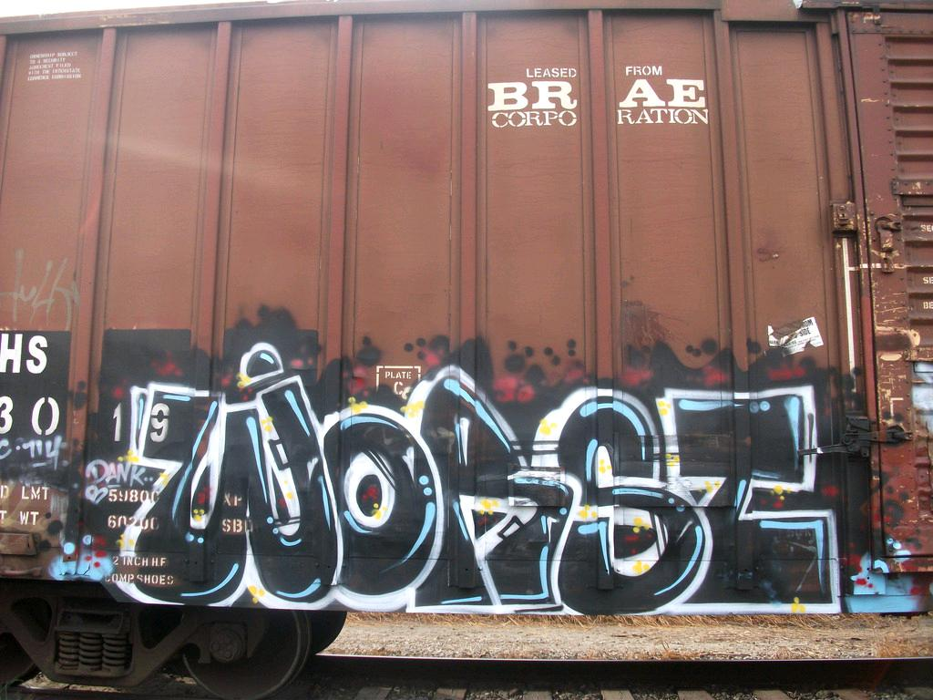
What's It Bad For
cc: friend without the r - https://www.flickr.com/photos/46998899@N02

Slide 27
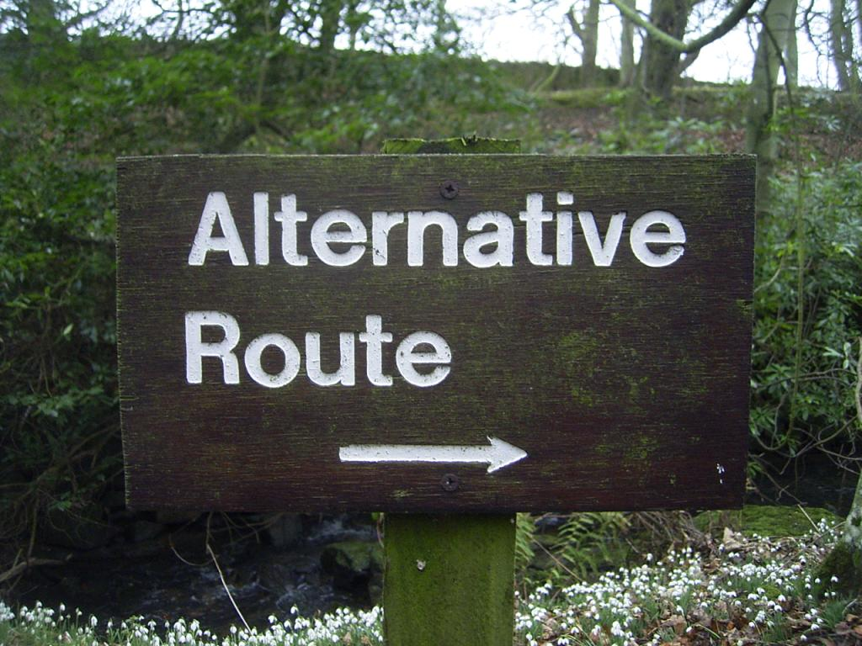
cc: duncan - https://www.flickr.com/photos/34427470616@N01
Notes:
there are several different design patterns that might be used to accomplish this same behavior

Slide 28

ok so we have a simple application that can send out messages to all users of this socket.io endpoint
cc: MARK ADRIANE - https://unsplash.com/@markadriane?utm_source=haikudeck&utm_medium=referral&utm_campaign=api-credit

Slide 29

lets build out a front-end
cc: mkhmarketing - https://www.flickr.com/photos/93212162@N08

Slide 30
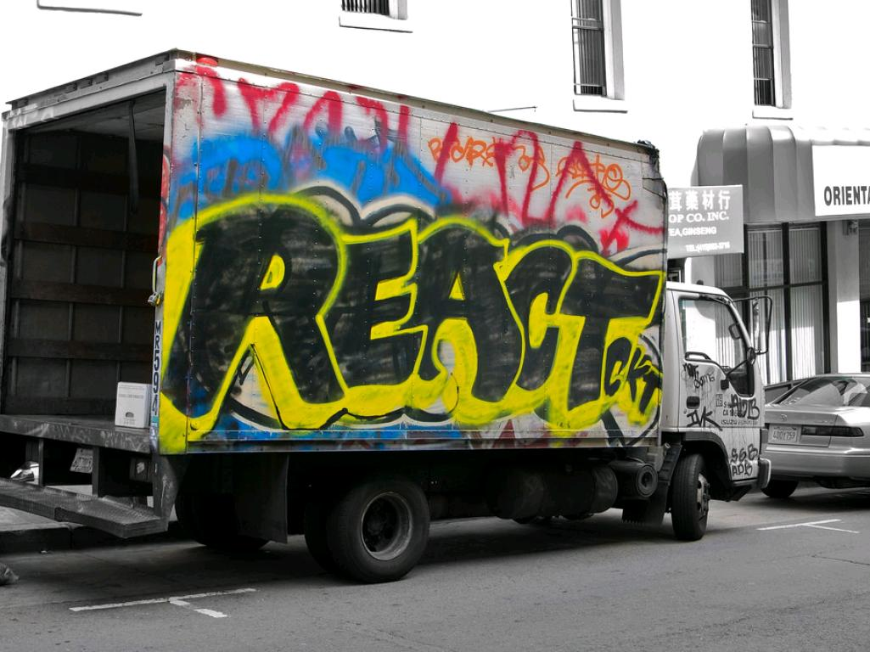
I really like using react to build out front-end so we'll use create-react-app a great tool to get up to date with
cc: Louis Abate - https://www.flickr.com/photos/25132305@N05

Slide 31

javascript doesn't have an observer pattern yet but there is a proposed spec
cc: mag3737 - https://www.flickr.com/photos/50318388@N00

Slide 32

so let's use a library that has an Observer implementation
cc: wonderfully complex - https://www.flickr.com/photos/41598237@N00

Slide 33

enter rxjs
cc: Mr.Tea - https://www.flickr.com/photos/12575062@N00

Slide 34

I was originally going to discuss using redux here but I hate redux
cc: Ò® - https://www.flickr.com/photos/7811493@N07

Slide 35
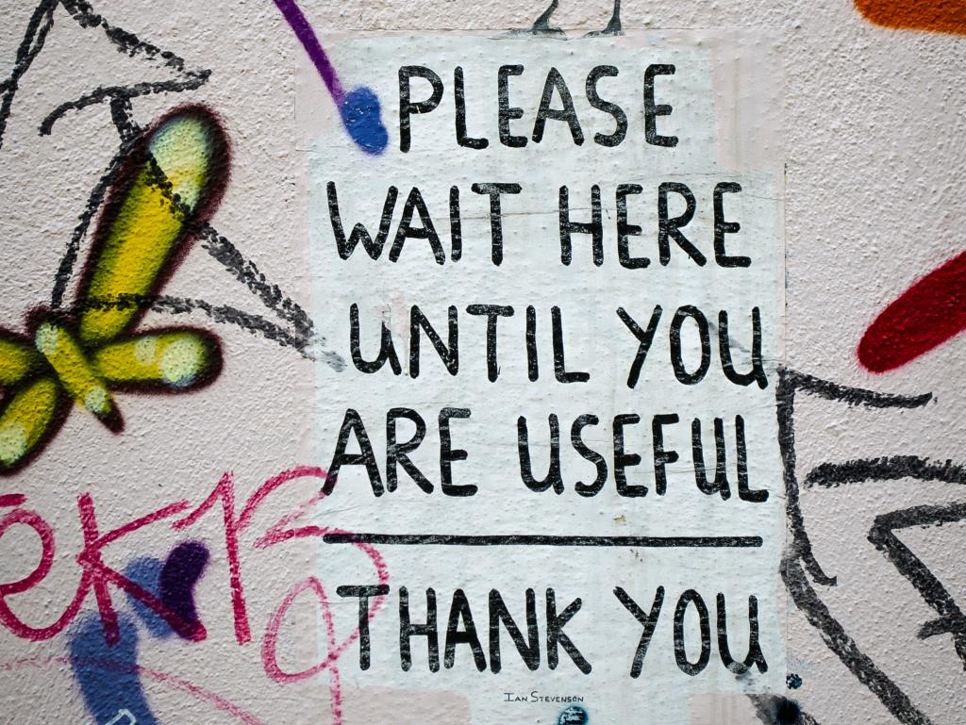
wait weren't we talking about the observer pattern
cc: garryknight - https://www.flickr.com/photos/8176740@N05

Slide 36

There are other implementations but this one is best
cc: Martin Shreder - https://unsplash.com/@martinshreder?utm_source=haikudeck&utm_medium=referral&utm_campaign=api-credit

Slide 37
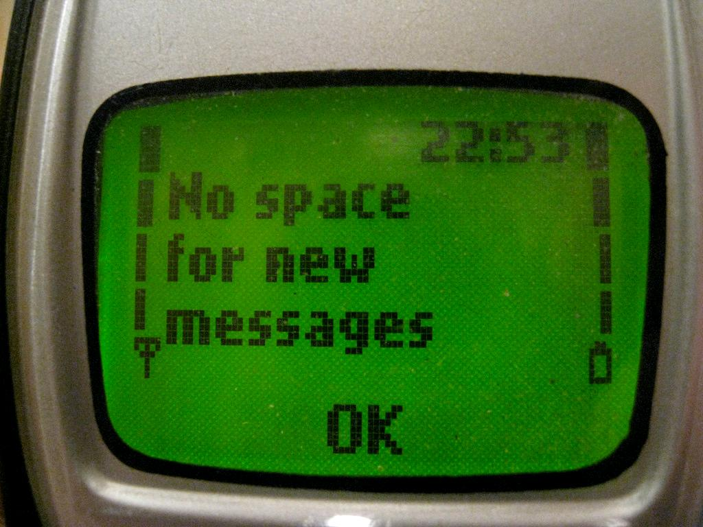
so rxjs observer will expect to be notified from socket.io about and dispatches messages to anyone listening
cc: mangee - https://www.flickr.com/photos/64937321@N00

Slide 38
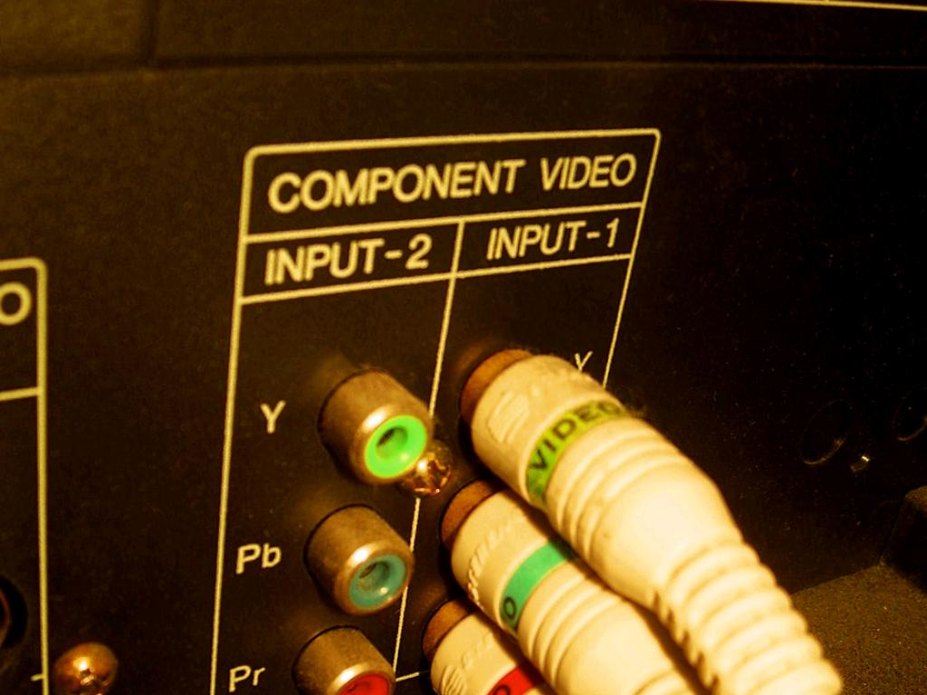
react component state will be updated and voila the user is now in the queue
cc: Pete Prodoehl - https://www.flickr.com/photos/35237092540@N01

Slide 39
so let's add some more stuff and code this up
cc: Lord James [Web Developer] - https://www.flickr.com/photos/51098911@N07

Slide 40
Socket Client
constructor(props) {
super(props);
const socket = openSocket("http://localhost:3000");
socket.on("rfid", function(msg) {
let decoder = new TextDecoder();
let decodedMessageText = decoder.decode(msg);
console.log(decodedMessageText);
});
}
Notes:
A simple integration by adding to the App.js component constructor to handle the connection

Slide 41

What we learned
cc: Anne Davis 773 - https://www.flickr.com/photos/46353871@N00

Slide 42
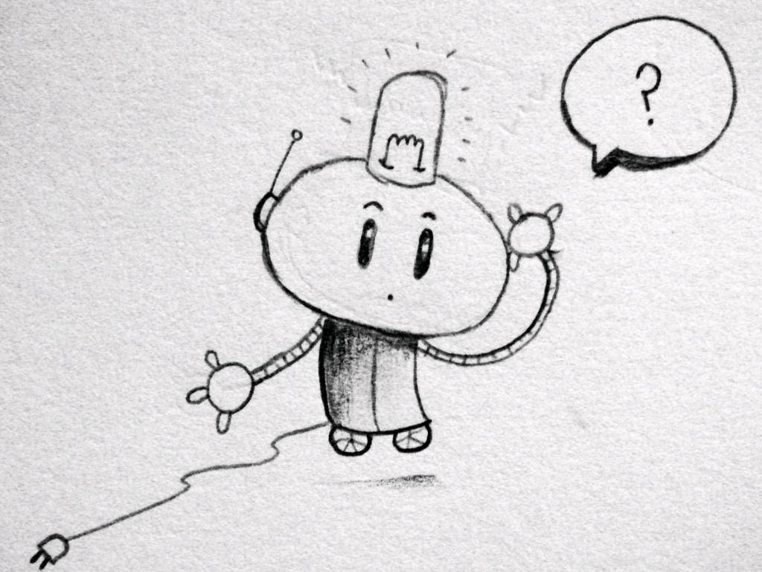
Q & A
cc: matt hutchinson - https://www.flickr.com/photos/17524395@N00

